Slide 1
Decision Dashboard for Urban Food Production
Weekly Progress Update
Chiranjeevi Venkata Shiva Ruthvik Savaram, Y247K345, 9/23/2026

Slide 2
Tasks
Previous Week
This Week
• Prepared and delivered the scenario impact & priority stability analysis presentation
• Used CDC PLACES datasets for the analysis(Completed)
• Explored structure, size, and data types of all 4 files (Completed)
• Checked missing values across datasets (Completed)

Slide 3
Datasets Received
4 CDC PLACES files — health category only, nationwide as received
Dataset
Geography
Rows
Columns
Census Tract (GIS-Friendly)
Census Tract
72,337
81
Local Data for Better Health — Tract
Census Tract
2,555,113
23
Local Data for Better Health — Place
Census-designated place
2,054,768
21
ZCTA (GIS-Friendly)
ZIP Code Tabulation Area
32,409
77
The Local Data files use a long-format structure, with one row per geographic-unit/measure pair. This is why their row counts are much larger — they are not one row per geographic area. The four datasets currently provided cover the health category; the remaining project data categories will be incorporated as they become available.
Decision Dashboard for Urban Food Production — Weekly Progress
3

Slide 4
Dataset Structure & Exploration
Representative fields — Census Tract file
data_files = list(data_folder.glob("*.csv"))
StateAbbr / CountyName / TractFIPS
Identify the state, county, and census tract.
for file in data_files:
df = pd.read_csv(file, nrows=10)
TotalPopulation
print(file.name, len(df.columns))
Population associated with each tract.(Integer)
# count rows using 100000 row chunks from original dataset
OBESITY_CrudePrev, DIABETES_CrudePrev,
ACCESS2_CrudePrev, BPHIGH_CrudePrev
row_count = 0
for chunk in pd.read_csv(file,
Tract-level health/access measures.(float)
chunksize=100000):
Geolocation
row_count += len(chunk)
Stores a geographic point for the tract, currently represented as a string.
# missing-value counts use this same
# chunked pattern, summed per column
Files are large, so rows and missing values are counted in 100,000-row chunks rather than loading everything into memory. Used pandas only; the ArcGIS Python API has not been used at this stage.
Decision Dashboard for Urban Food Production — Weekly Progress
4

Slide 5
Data Quality
Missing-value check — Census Tract file (81 columns, 72,337 rows)
Variable
Missing Records
% of Tracts
ACCESS2_CrudePrev (and similar measures)
4,165
5.8%
CERVICAL_CrudePrev
17
0.02%
COLON_SCREEN_CrudePrev
33
0.05%
MAMMOUSE_CrudePrev
84
0.12%
TEETHLOST_CrudePrev
99
0.14%
Missing values are concentrated in several health measures — for example, 4,165 tracts (5.8%) are missing ACCESS2 and many similar measures. CDC PLACES does not report estimates for some geographic units below a population threshold, but this hasn't yet been verified against every missing value in this file. No imputation or removal has been performed; that decision depends on which variables are ultimately selected for the suitability criteria.
Decision Dashboard for Urban Food Production — Weekly Progress
5

Slide 6
Next Week Plans (9/30/2026)
Activities/Tasks
• Identify the Kansas City metro geographic scope using the official Census/OMB metropolitan area delineation
• Shortlist candidate health variables relevant to the suitability criteria
• Review any additional data categories (demographic, economic, built-environment, vacant land) if provided
Expected Outcomes
• A defined project-area subset of the dataset
• An initial variable shortlist for the MCDM criteria
Deliverable
• Filtered dataset subset, variable shortlist, progress presentation

Slide 7
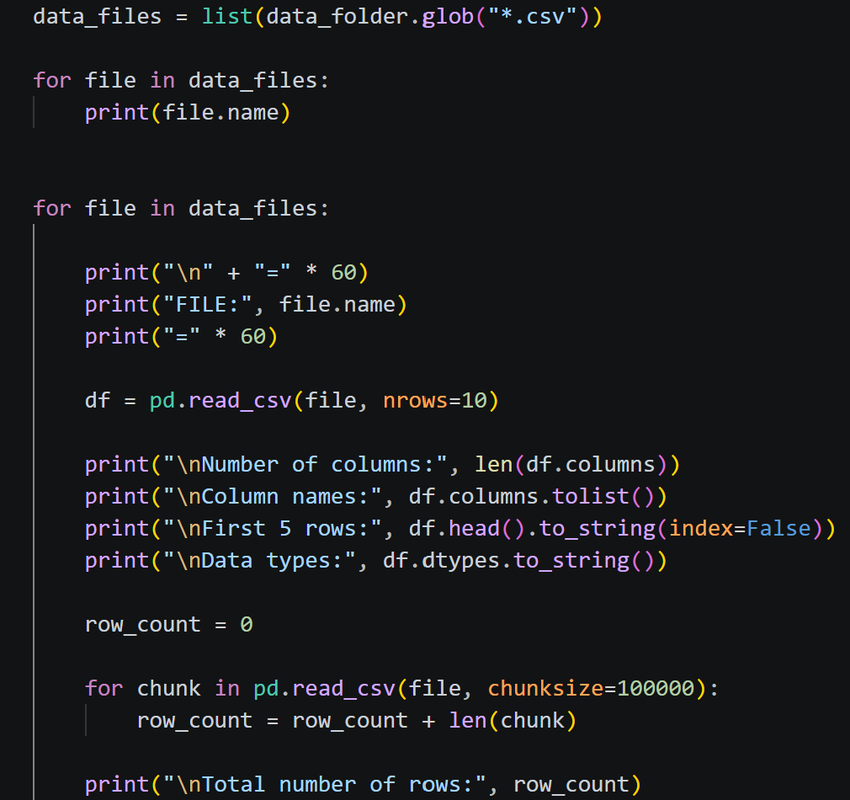
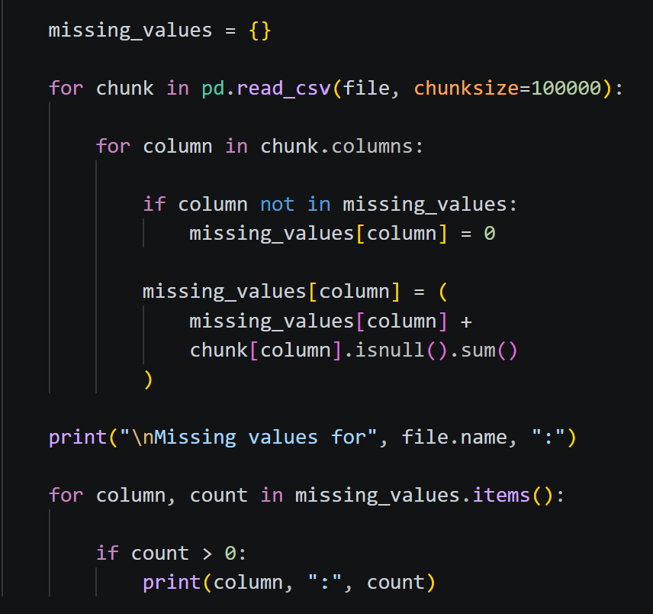
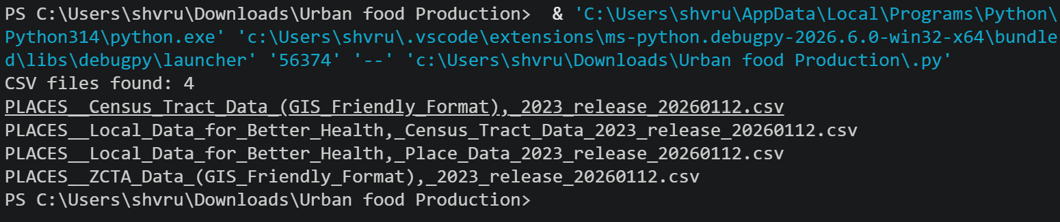
Data Exploration Code Used
Structure & row-count exploration
Missing-value counting (chunked)
Datasets used for the project

